Slide 1
Quora: predict duplicated questions
Asmaa Chraibi

Slide 2
Scope
Develop a classifier model to identify duplicated questions

Slide 3
Process
EDA
Data preparation
Features Engineering
Tested Models
Selected Model and Evaluation Metrics

Slide 4
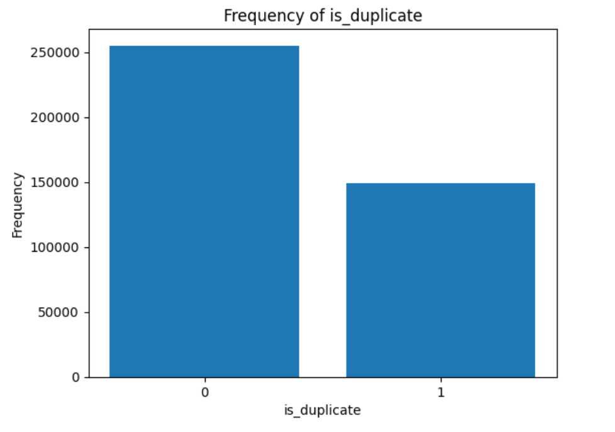
EDA in a glace
3 missing questions
Class imbalanced
537933 unique questions 66% of the total

Slide 5
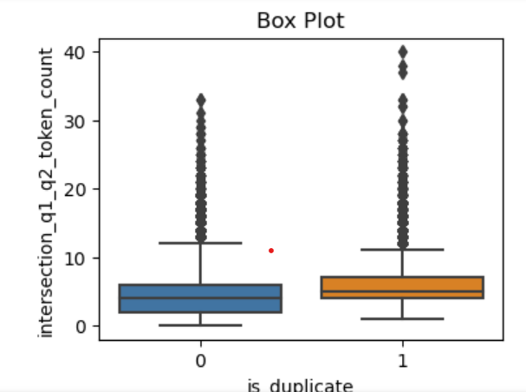
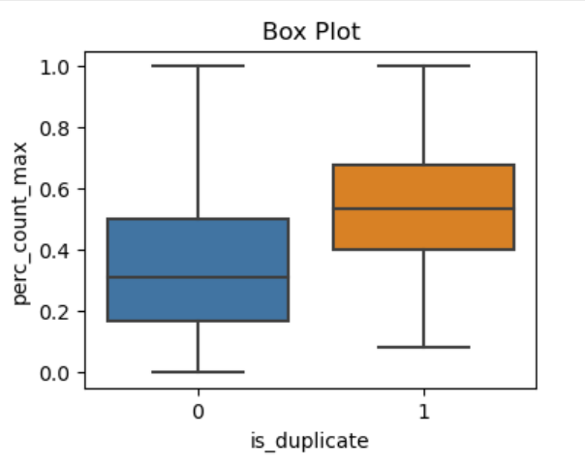
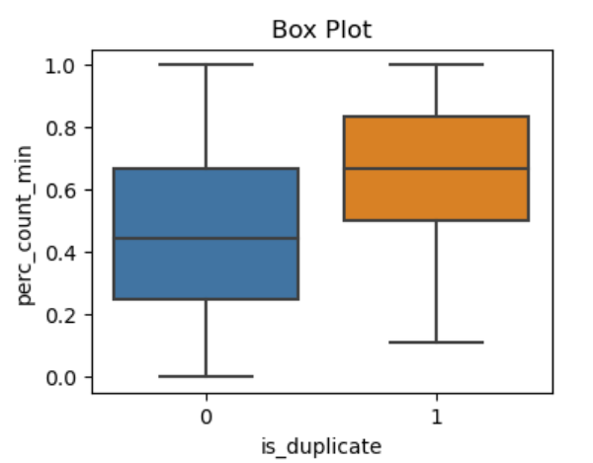

Slide 6
Feature Selection
Bag Of Word
TD IDF
Word2vec
Percentage min
Percentage max
Similarity value

Slide 7


Models and evaluation
Regression with Word2vec
similarities value
XG BOOST With Word2vec similarities value

Slide 8
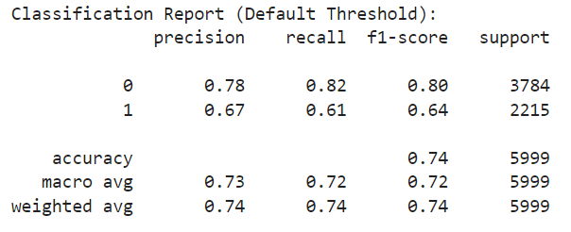
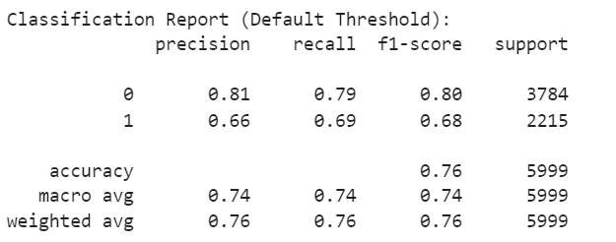
Models and evaluation
Regression with BOW
XG BOOST With BOW

Slide 9
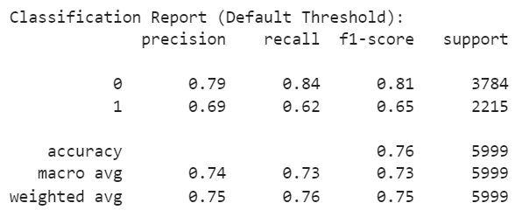
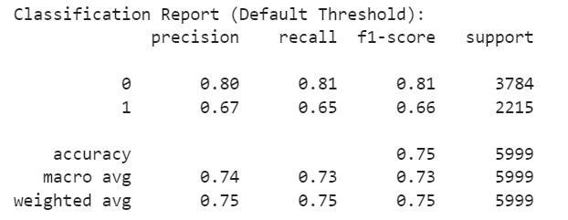
Models and evaluation
Regression with Td_IDF
XG BOOST With Td_IDF

Slide 10
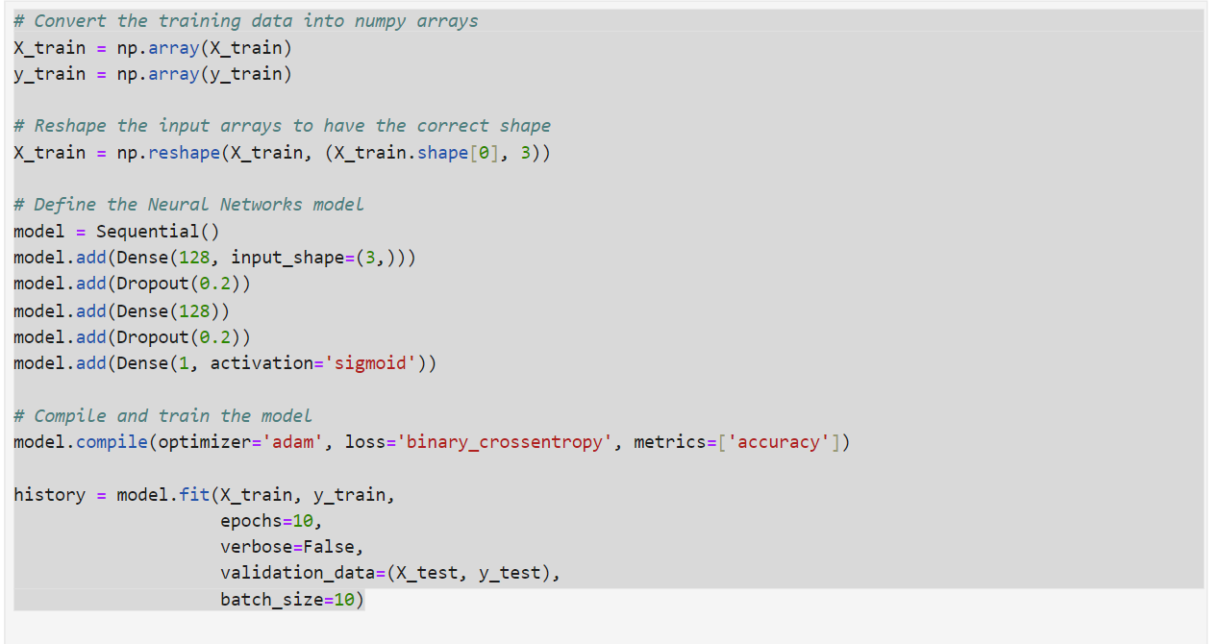
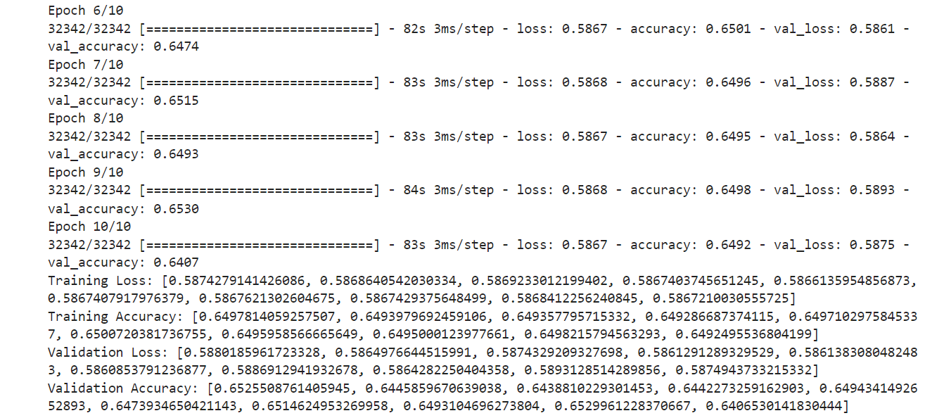
Neuron Network

Slide 11
Future Steps
Challenges
Future Steps
Balance the classes
More Feature engineering
Learn how to build effectively NN
Use Google collab as solution for machine limitation

